Slide 1
British Red Cross
Met Office Hackathon
March 2021

Slide 2
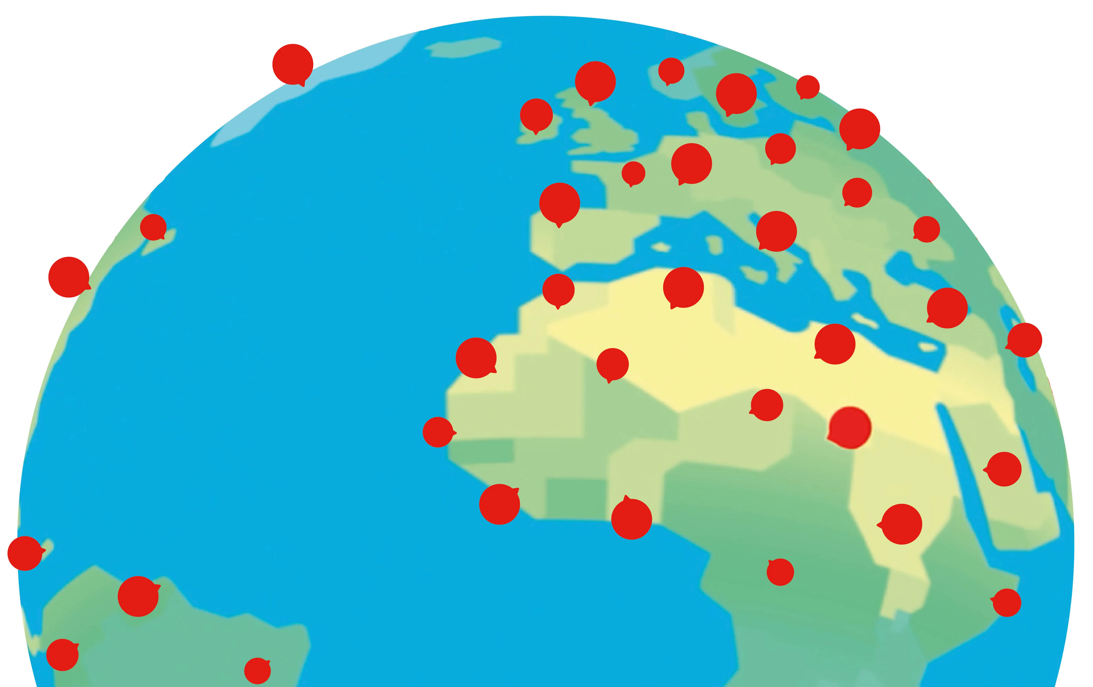
Background & Context
The Red Cross Red Crescent Movement is active in 192 countries worldwide, with ~12 million volunteers.
Each year disasters around the world cause thousands of deaths and impact livelihoods.
A weather- or climate-related disaster occurs every 1-2 days, and climate change is only leading to increasing trends in terms of frequency and scale.

Slide 3
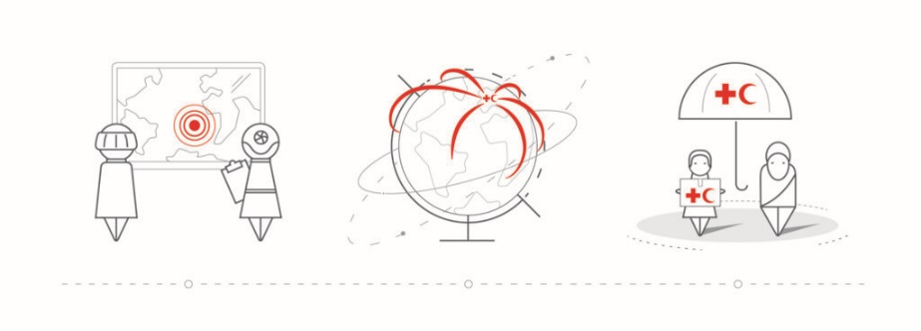
Background & Context
Impacts of disasters are unequal, as the coping capacity of impacted people is based on their resources to protect themselves – limited in areas where climate impacts like floods, droughts or storms hit hardest. These inequalities of the effects of weather- or climate-related disasters can be reduced.
We can combine forecasts and risk analyses to implement early action activities we can help to protect lives and livelihoods.

Slide 4
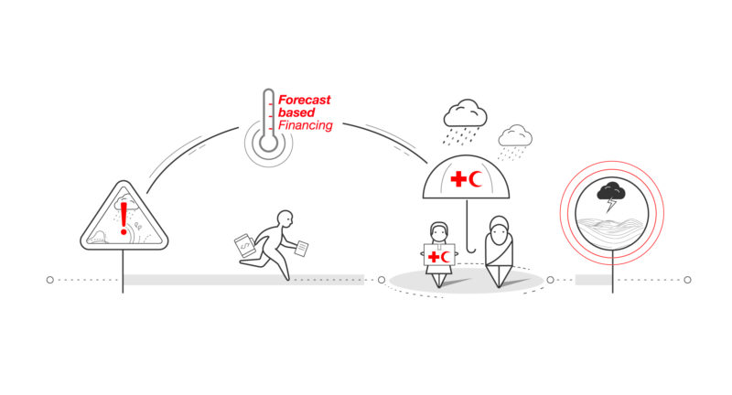
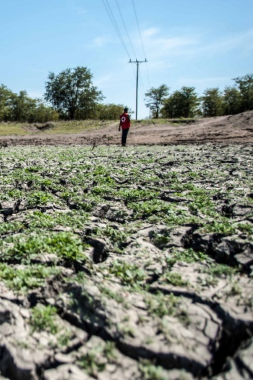
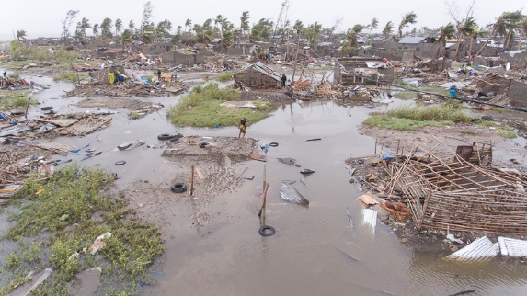
Background & Context
We’re moving to an anticipatory approach, using weather and climate data and vulnerability and exposure information, to help planning and anticipation of disasters so communities are prepared, and national organisations can provide an effective response before disasters hit.

Slide 5

Challenge:
How can we support communities and organisations in ‘data poor’ environments such as in the Sahel and parts of Southern Africa to know when and where to get ready for a disaster?

Slide 6
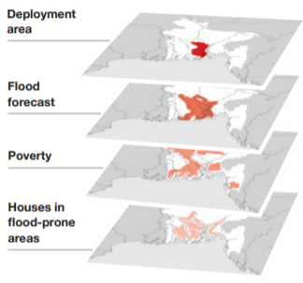
The Challenge: Statement
Many places where disasters occur often lack vulnerability and exposure data about communities at risk. Hydro-meteorological data can also be sometimes lacking.
These data points are critical to creating triggers protocols which hydro-meteorological services and communities agree on and early action protocols that are carried out once a forecast reaches a certain threshold.
This data can help prompt early humanitarian action, which can help save lives and reduce the impact of the disaster.

Slide 7

The Challenge: Question
What approach can be taken to collect data to feed into impact-based forecasts from data poor locations (with a focus on vulnerability and exposure data) in the Sahel and southern parts of Africa?
Could we crowdsource data? How can volunteers act as agents to feed into impact-based forecasts? What data could local volunteers collect within a country to feed into impact-based forecasts?
What would they collect?
How would they collect and report it?
How would it be visualised for decision makers to respond?

Slide 8
The Challenge: Secondary question
What other datasets are useful for identifying exposure and vulnerability? E.g., How can OpenStreetMap data be used? Does this have to focus on mapping roads, houses and buildings. This is useful for flood risk but might have less clear use for drought risk)
What attributes might be useful to know (public or internal) for different disasters?
What open data sets are available that can be used to support this.

Slide 9

Potential Outputs
A methodology to collect community, and household level vulnerability data to then incorporate into Impact based Forecast programmes in data poor locations, with a focus on drought.
Identification of how this data would vary between emergencies, such as flooding vs. drought.
A process for crowdsourcing vulnerability and exposure datasets (and hydro-met data)
Datasets which could be collected, crowdsourced, or via a different method, highlighting their openness, type (e.g., geographical) and attributes.
An approach to integrating the methodology and datasets into Impact based financing programmes.

Slide 10

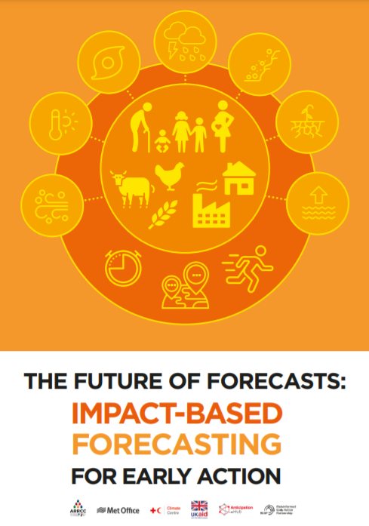

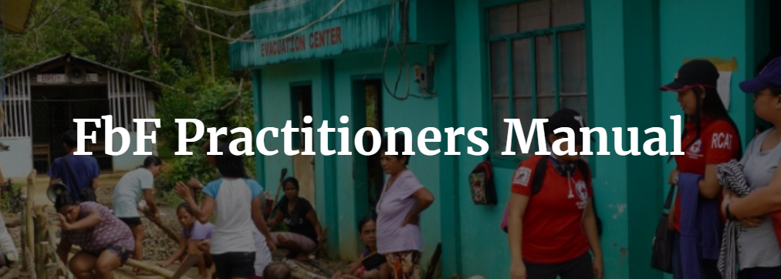
Further Information
Video: Introduction to impact-based forecasting https://vimeo.com/456462214
Forecast based Finance methodology: https://www.forecast-based-financing.org/methodology/
Impact based forecasting guide: https://www.forecast-based-financing.org/wp-content/uploads/2020/09/Impact-based-forecasting-guide-2020.pdf (Risk Analysis sections)
Forecast based Finance Practitioners Manual: https://manual.forecast-based-financing.org/ (Early Action Protocol and Risk Analysis sections)
Missing Maps Project: https://www.missingmaps.org/
OpenStreetMap: https://www.openstreetmap.org/

